Slide 1

Activity Recognition using gestures
Group No: E3 Date : 26/08/2014

Slide 2
TEAM MEMBERS:
Gopi Thulasinathan T - CB.EN.U4CSE11414
Sravanthi N - CB.EN.U4CSE11428
Narasimha Prasath K - CB.EN.U4CSE11429
Rahul E - CB.EN.U4CSE11439
Varun Kumar A - CB.EN.U4CSE11458
PROJECT GUIDE :
Ms. Padmavathi S.

Slide 3
Problem Statement
To develop Articulated human body model by using the limbs and joints, and to track the human motion in a video sequence.

Slide 4
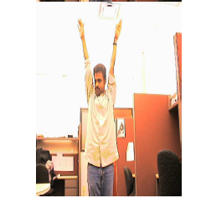
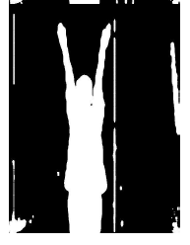
Background Subtraction

Slide 5
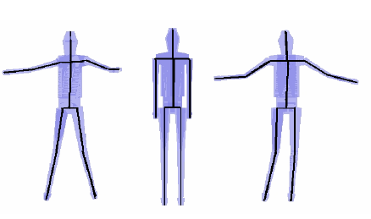
Modeling the object being tracked

Slide 6
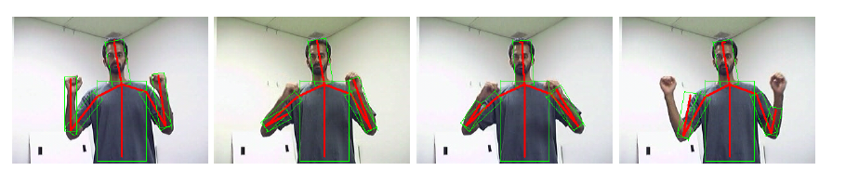
Tracking

Slide 7
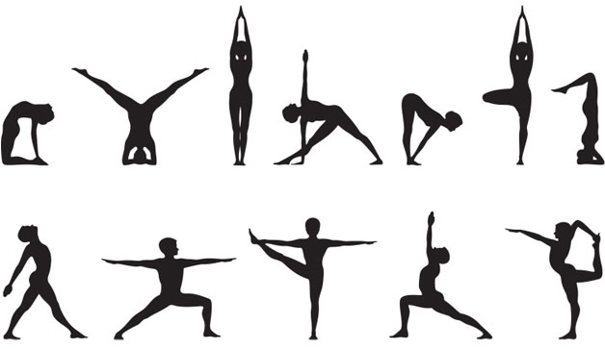
Gesture Detection and Analysis

Slide 8
Applications
Can detect various movements involved in
Video Surveillance
Exercise Postures
Yoga Asanas
Dance movements

Slide 9
References
Mun Wai Lee and Isaac Cohen, “Human Upper Body Pose Estimation in Static Images”, T. Pajdla and J. Matas (Eds.): ECCV 2004, LNCS 3022, pp. 126–138, 2004, Springer-Verlag Berlin Heidelberg 2004.
Li, Jing-Feng, Xu, Yi-Hua; Chen, Yang; Jia, Yun-De “A Real-Time 3D Human Body Tracking and Modeling System” IEEE International Conference on Image Processing, 2006
MANIMALA S & C. N. RAVI KUMAR, ENVISAGING TORSO AND FOOT FEATURES OF HUMAN BODY USING TOPINARD’S CANON SYSTEM, International Journal of Management, Information Technology and Engineering, Vol. 2, Issue 1, Jan 2014, 91-96
http://www.cvpapers.com/eccv2004.html

